Slide 1






Purple Futures: Culturing the next wave of biotech commercialisation 9th Workshop of PURPLEGAIN COST Action IMPERIAL COLLEGE LONDON, UK
From fundamental metabolism to PPB production
24th of September 2025
Baptiste Leroy

Slide 2
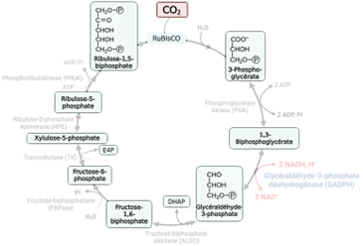
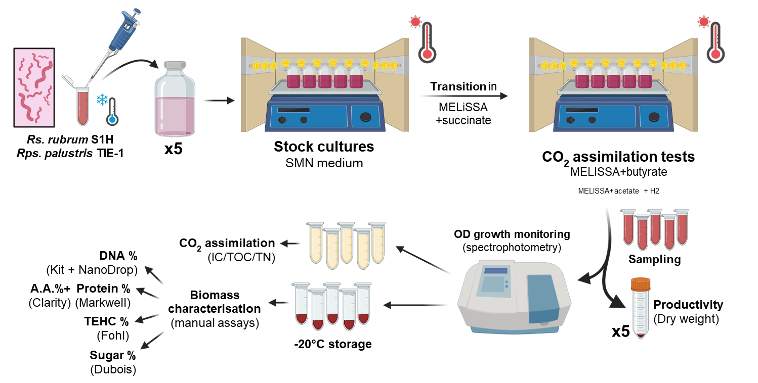
Study of the fundamental aspect of PPB metabolism
02
Notes:
One of the fastest and most efficient method currently available for genomic engineering is a system based on the Streptococcus pyogenes Cas9 endonuclease.
CRISPR-Cas9 = prokayotic system which consists of single-stranded guide RNA molecules (sgRNA) that guides an associated Cas9 endonuclease to a specific DNA region protospacer !!! based on sequence recognition (complementarity).

Slide 3
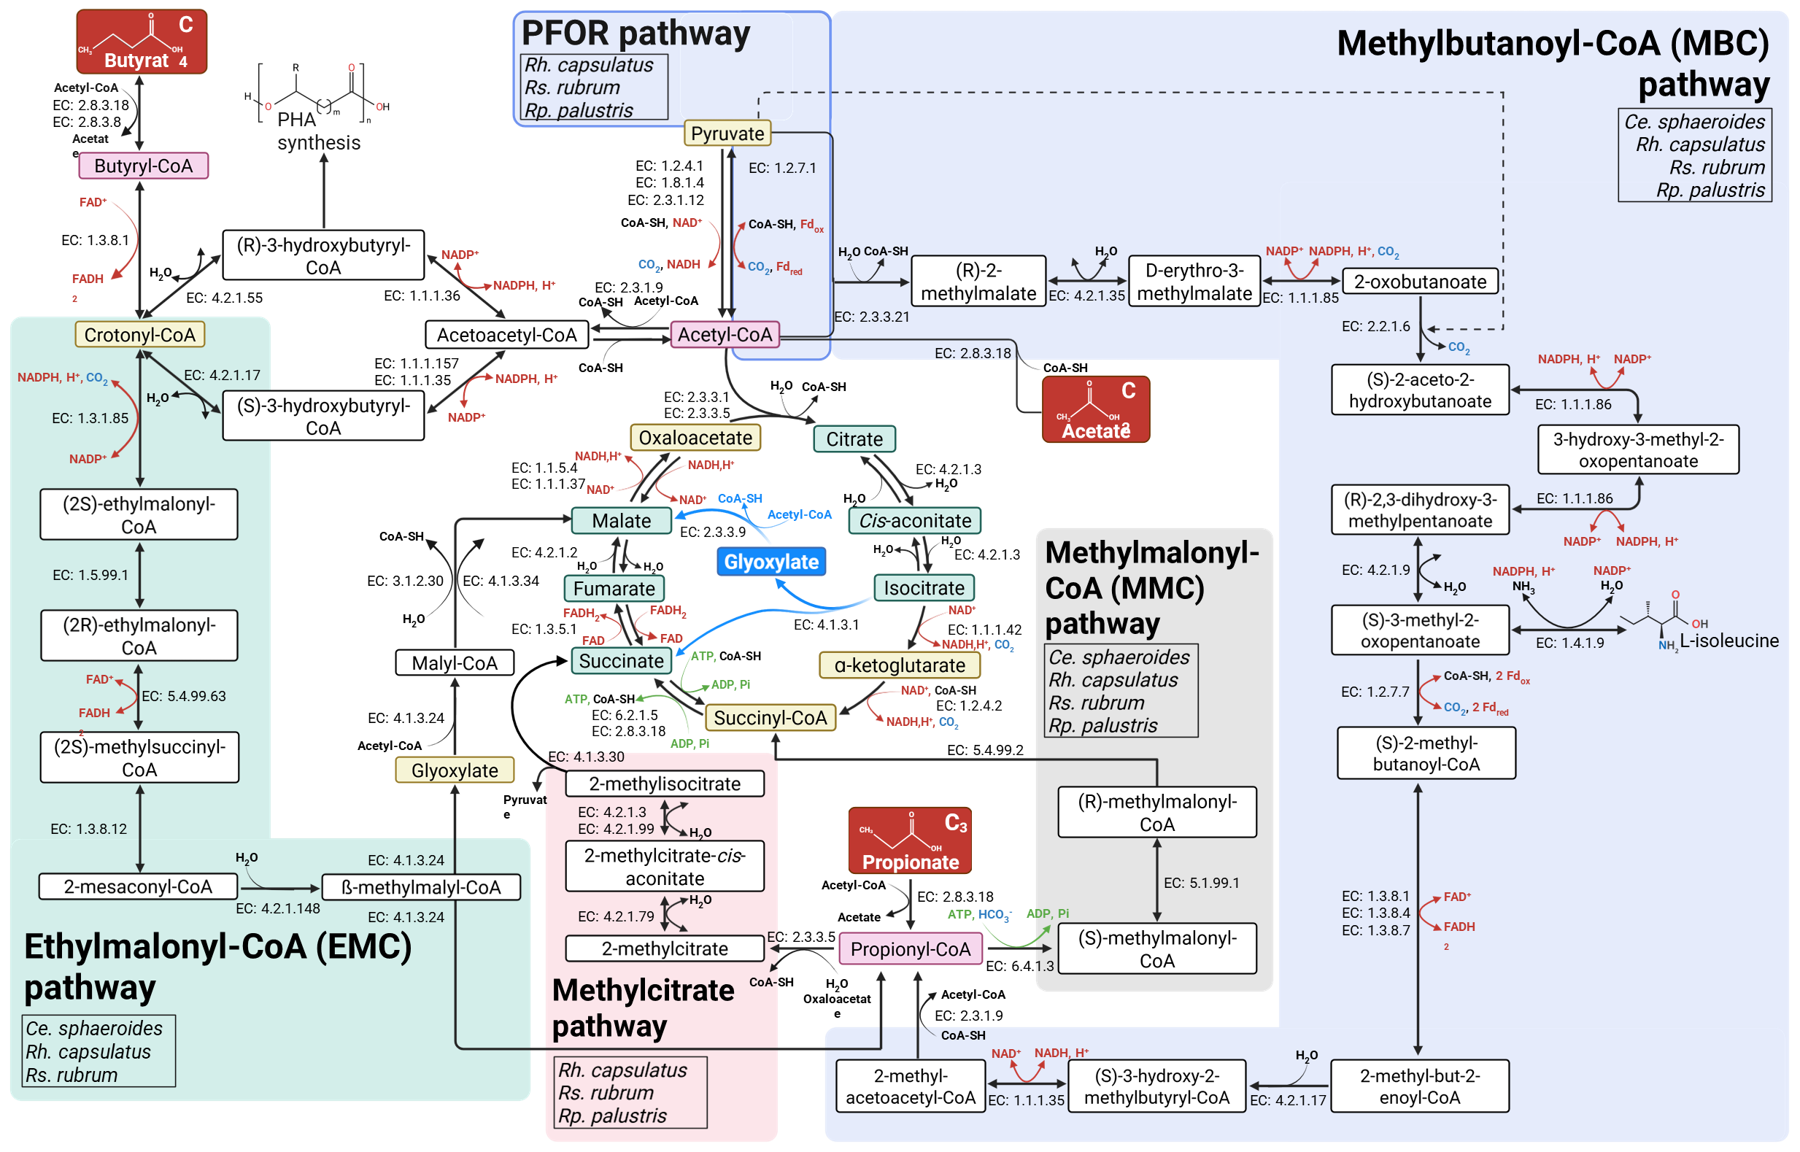
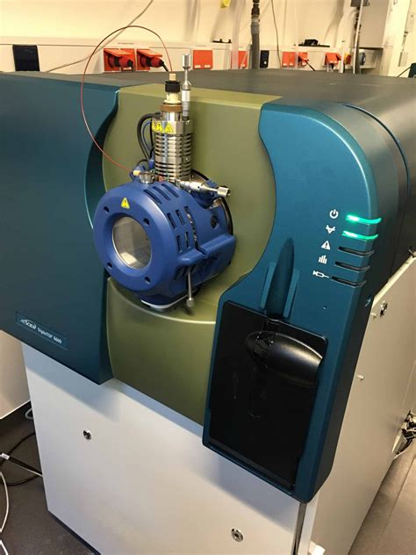
Study of the fundamental aspect of PPB metabolism
03
Notes:
One of the fastest and most efficient method currently available for genomic engineering is a system based on the Streptococcus pyogenes Cas9 endonuclease.
CRISPR-Cas9 = prokayotic system which consists of single-stranded guide RNA molecules (sgRNA) that guides an associated Cas9 endonuclease to a specific DNA region protospacer !!! based on sequence recognition (complementarity).

Slide 4


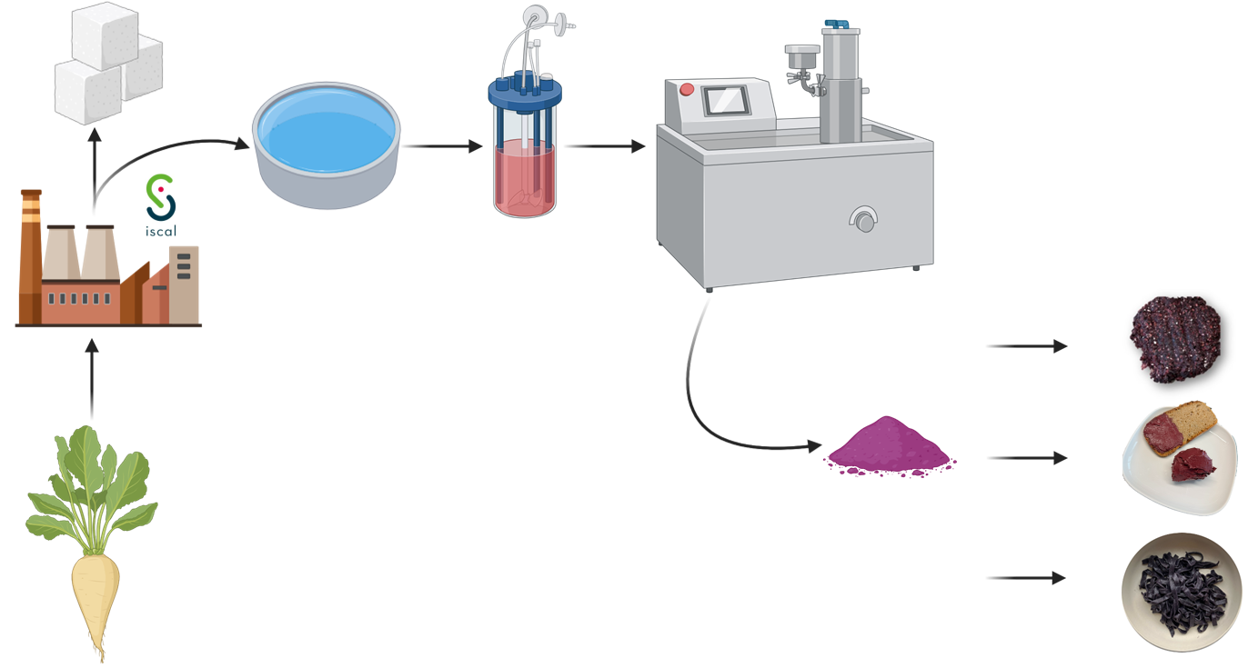









PROTEBoost project : impact for the society
Website : www.foodwal.be
04
Notes:
One of the fastest and most efficient method currently available for genomic engineering is a system based on the Streptococcus pyogenes Cas9 endonuclease.
CRISPR-Cas9 = prokayotic system which consists of single-stranded guide RNA molecules (sgRNA) that guides an associated Cas9 endonuclease to a specific DNA region protospacer !!! based on sequence recognition (complementarity).

Slide 5
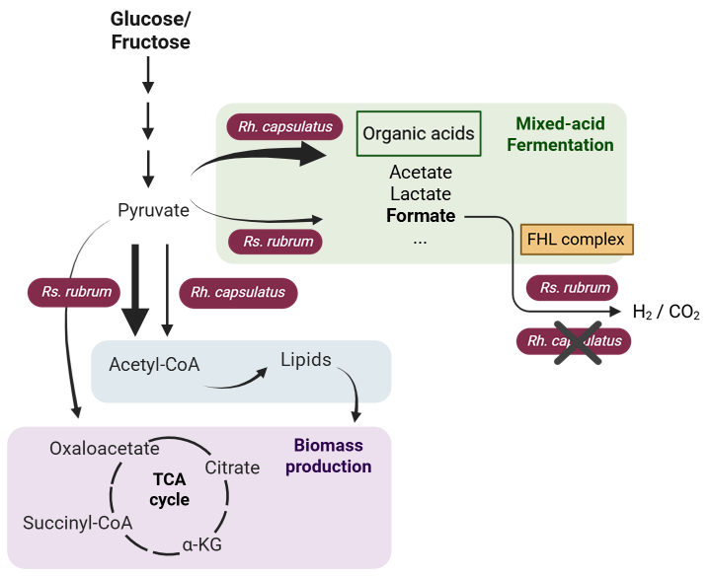
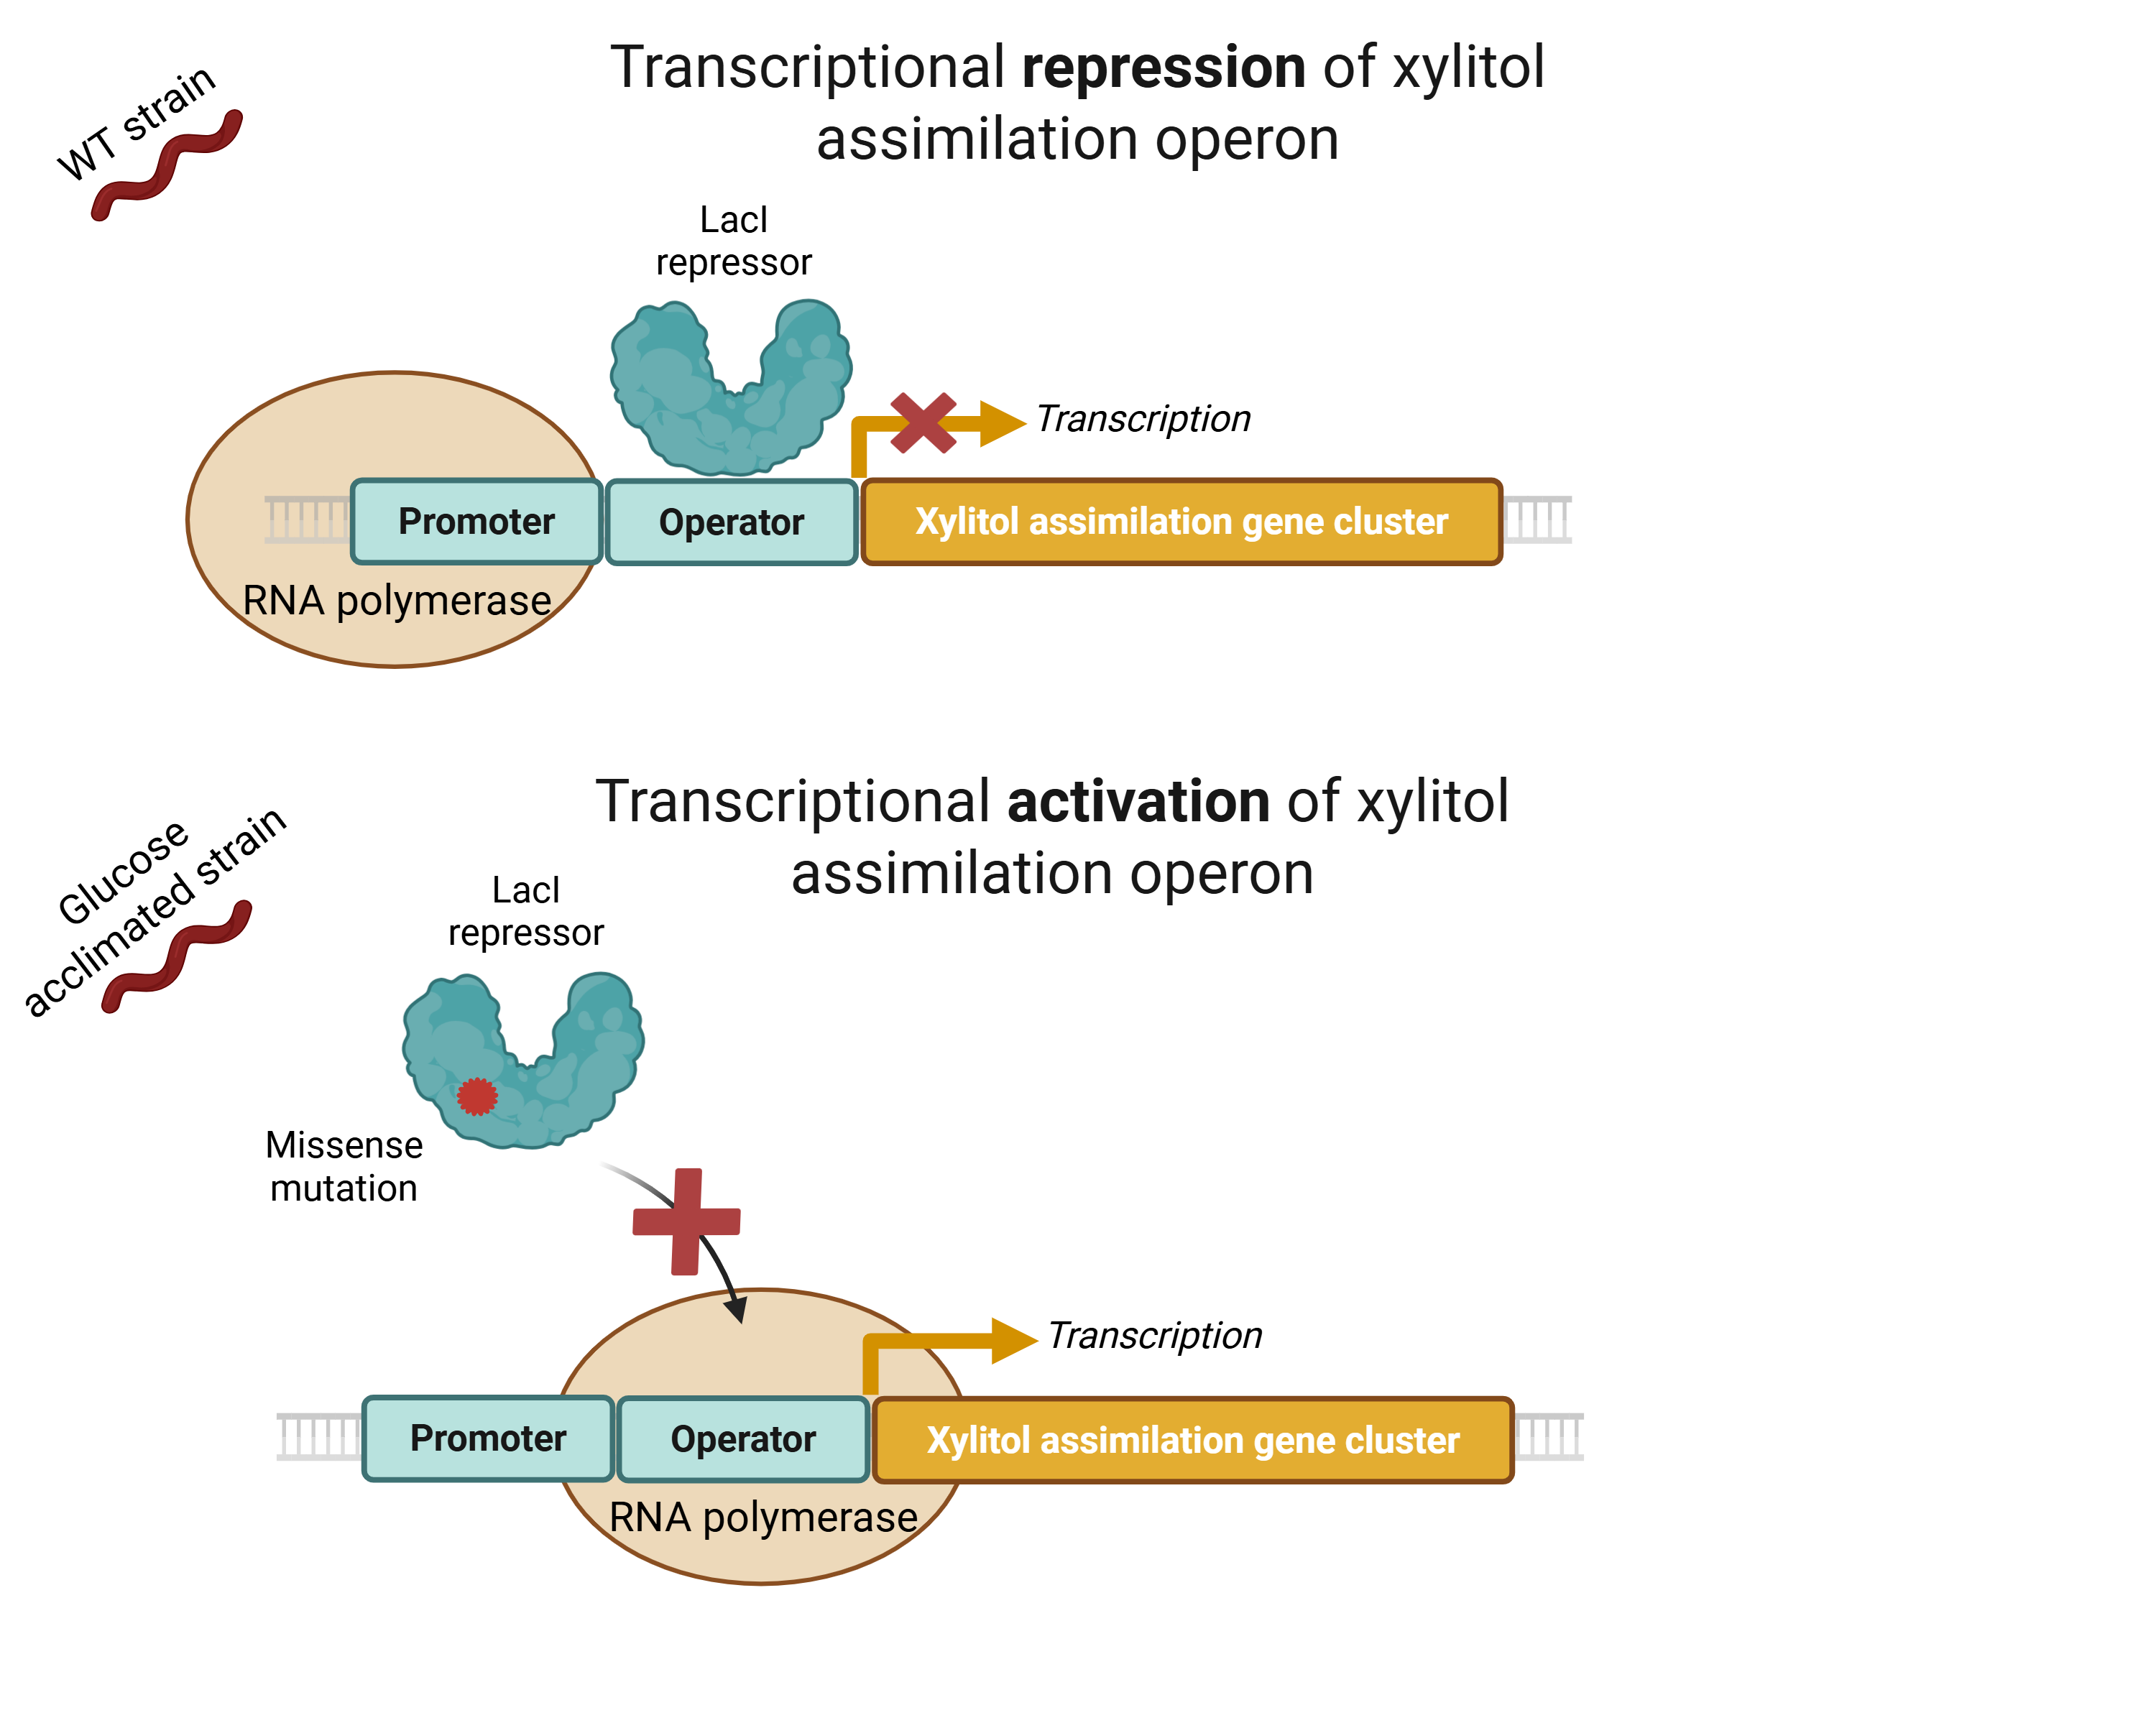

PPB metabolism for improved productivity
05
Notes:
One of the fastest and most efficient method currently available for genomic engineering is a system based on the Streptococcus pyogenes Cas9 endonuclease.
CRISPR-Cas9 = prokayotic system which consists of single-stranded guide RNA molecules (sgRNA) that guides an associated Cas9 endonuclease to a specific DNA region protospacer !!! based on sequence recognition (complementarity).

Slide 6
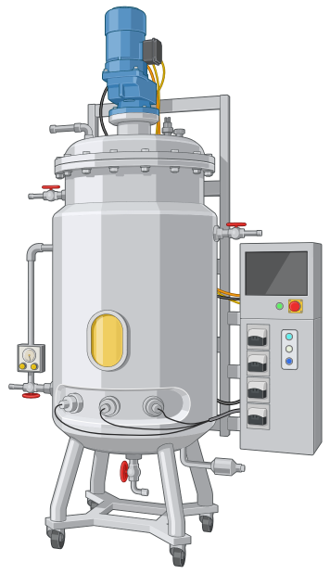
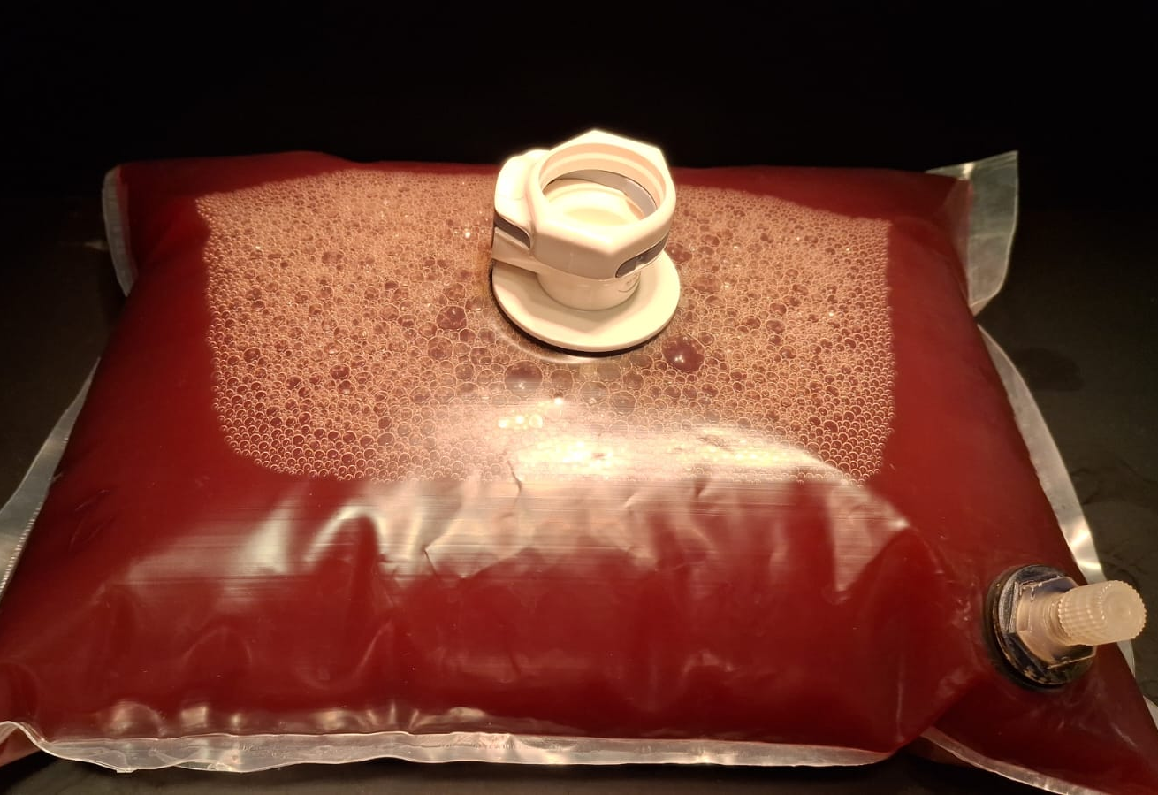

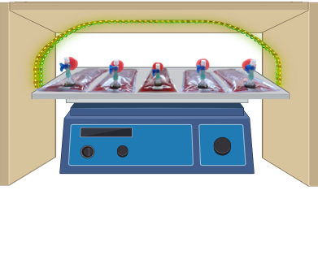
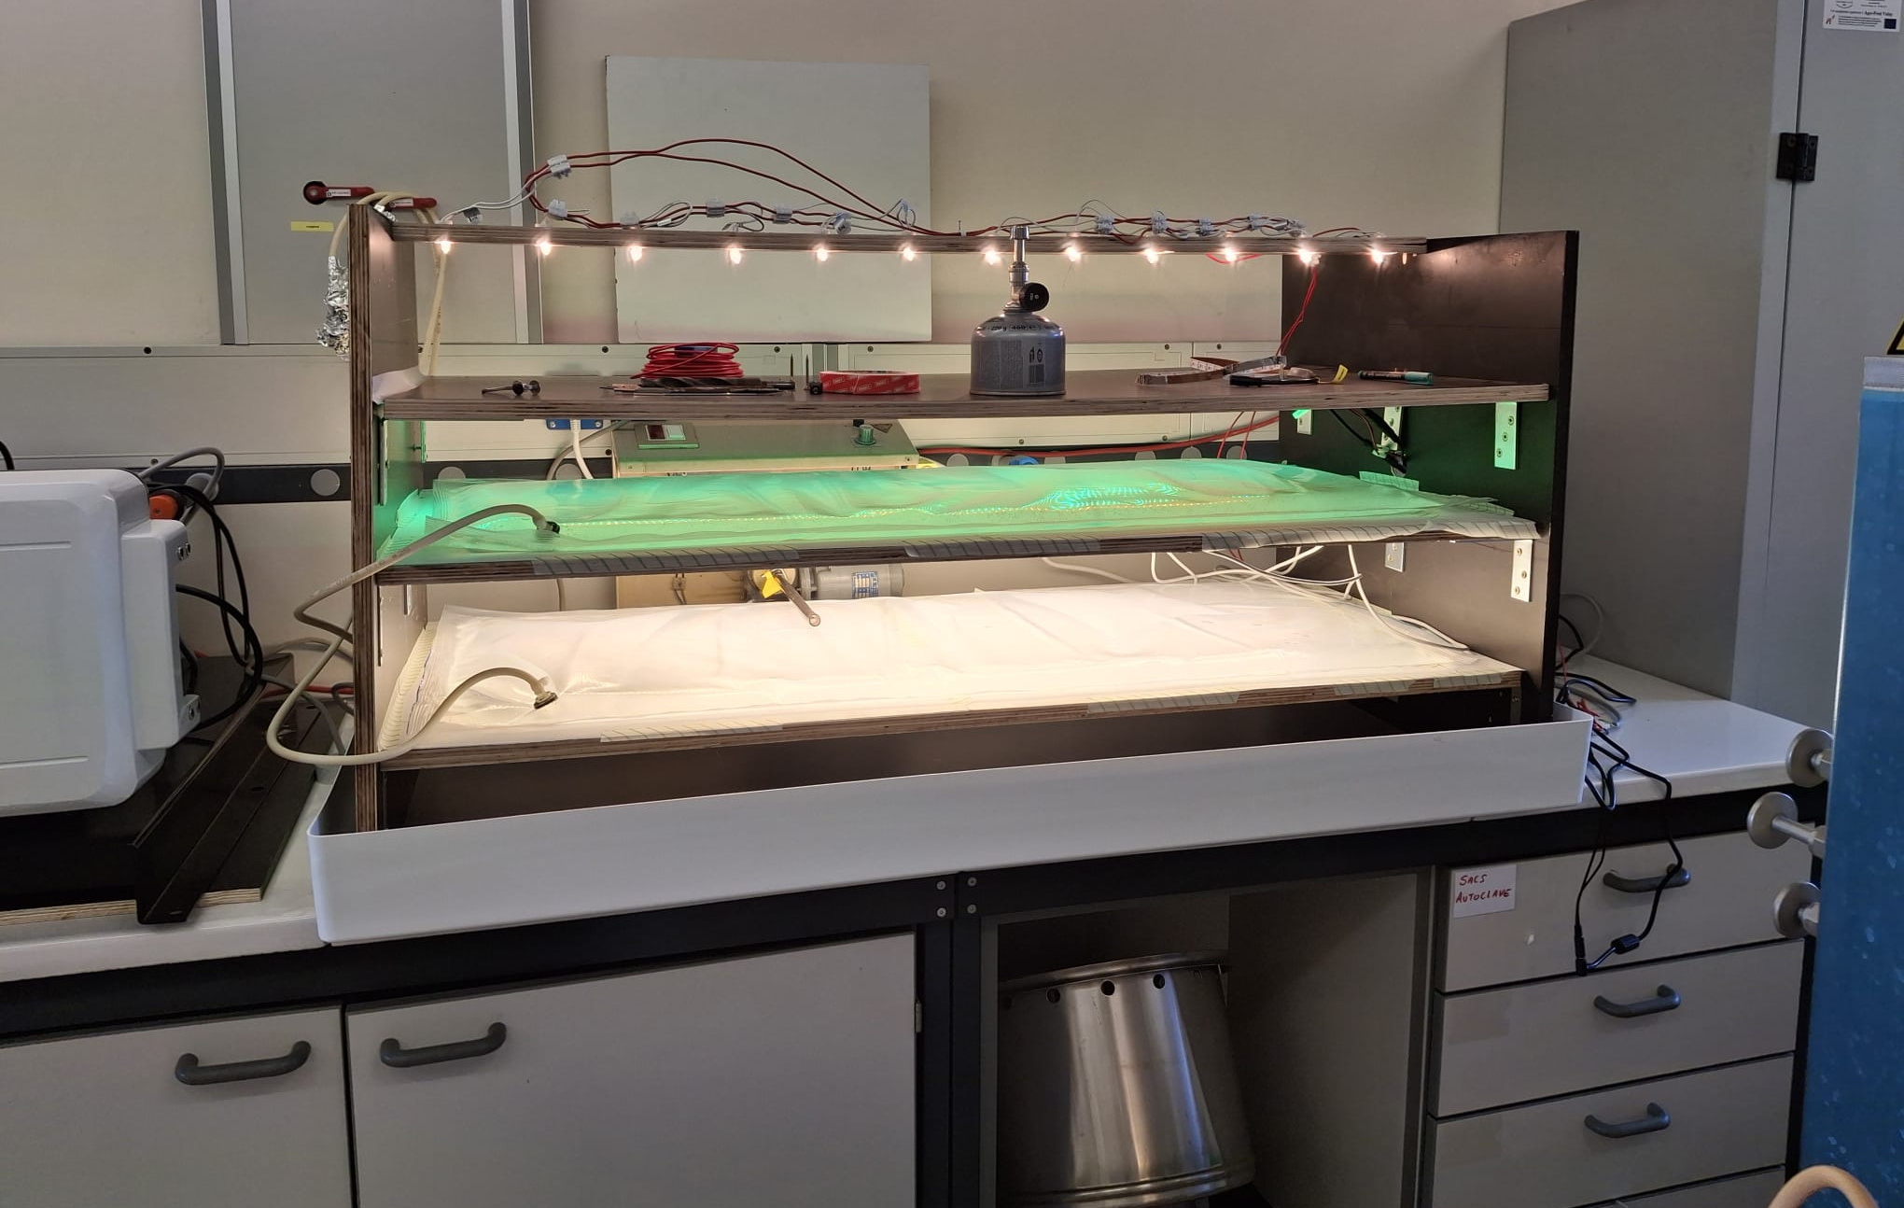

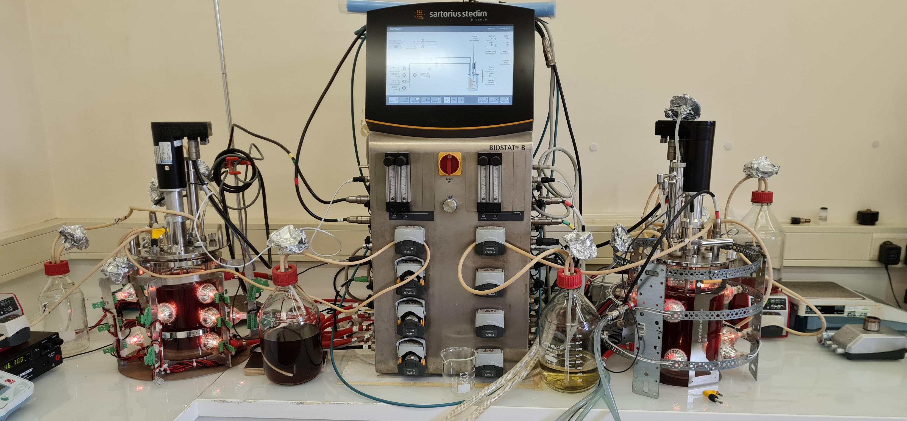
Feasability at larger scale?
06
Notes:
One of the fastest and most efficient method currently available for genomic engineering is a system based on the Streptococcus pyogenes Cas9 endonuclease.
CRISPR-Cas9 = prokayotic system which consists of single-stranded guide RNA molecules (sgRNA) that guides an associated Cas9 endonuclease to a specific DNA region protospacer !!! based on sequence recognition (complementarity).

Slide 7
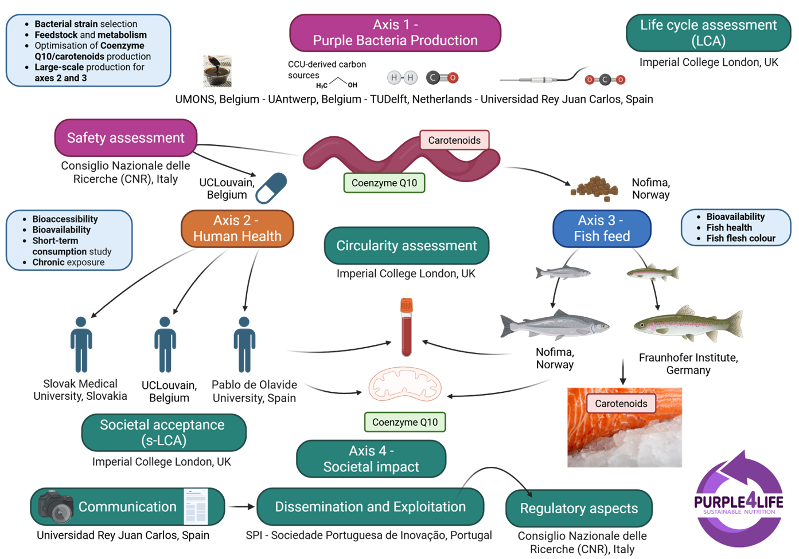



Purple4Life project
www.purple4life.eu
07
Notes:
One of the fastest and most efficient method currently available for genomic engineering is a system based on the Streptococcus pyogenes Cas9 endonuclease.
CRISPR-Cas9 = prokayotic system which consists of single-stranded guide RNA molecules (sgRNA) that guides an associated Cas9 endonuclease to a specific DNA region protospacer !!! based on sequence recognition (complementarity).

Slide 8



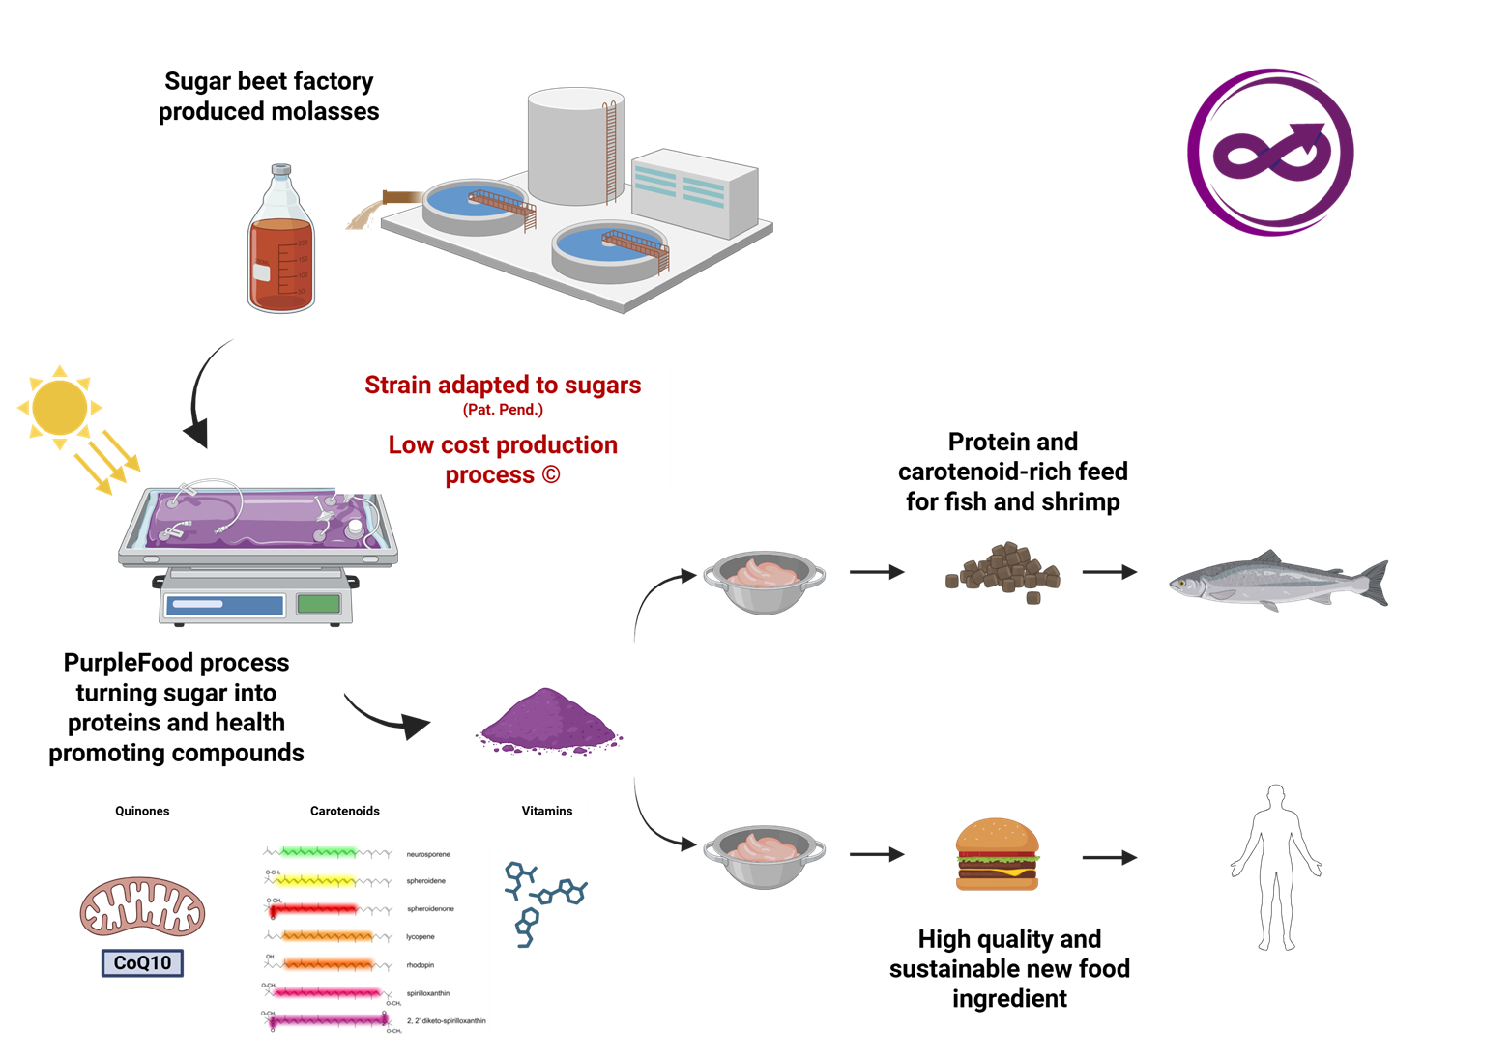
08
Notes:
One of the fastest and most efficient method currently available for genomic engineering is a system based on the Streptococcus pyogenes Cas9 endonuclease.
CRISPR-Cas9 = prokayotic system which consists of single-stranded guide RNA molecules (sgRNA) that guides an associated Cas9 endonuclease to a specific DNA region protospacer !!! based on sequence recognition (complementarity).

Slide 9



LowChol project
09
Notes:
One of the fastest and most efficient method currently available for genomic engineering is a system based on the Streptococcus pyogenes Cas9 endonuclease.
CRISPR-Cas9 = prokayotic system which consists of single-stranded guide RNA molecules (sgRNA) that guides an associated Cas9 endonuclease to a specific DNA region protospacer !!! based on sequence recognition (complementarity).

Slide 10




Guillaume Bayon-Vicente
Laura Toubeau
Manon Gilson
Vittorio Olivieri
Simone Krings
Abdessalem Agoudjil
Ruddy Wattiez
Thank you!
10
Notes:
One of the fastest and most efficient method currently available for genomic engineering is a system based on the Streptococcus pyogenes Cas9 endonuclease.
CRISPR-Cas9 = prokayotic system which consists of single-stranded guide RNA molecules (sgRNA) that guides an associated Cas9 endonuclease to a specific DNA region protospacer !!! based on sequence recognition (complementarity).

